Slide 1
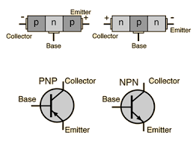
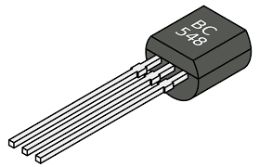
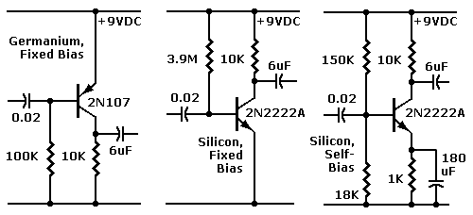
BJT Transistors

Slide 3
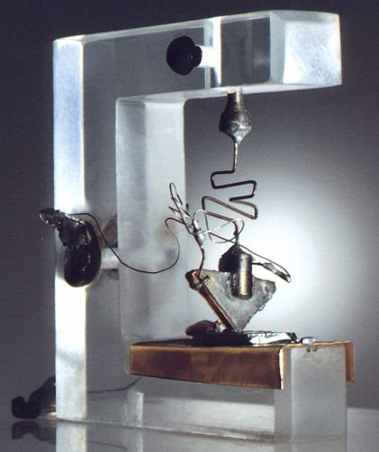
First - BJTs
The transistor was probably the most important invention of the 20th Century, and the story behind the invention is one of clashing egos and top secret research.
Reference:
Bell Labs Museum
B. G. Streetman & S. Banerjee ‘Solid State Electronic Devices’, Prentice Hall 1999.

Slide 4
Interesting story…
Picture shows the workbench of John Bardeen (Stocker Professor at OU) and Walter Brattain at Bell Laboratories. They were supposed to be doing fundamental research about crystal surfaces.
The experimental results hadn't been very good, though, and there's a rumor that their boss, William Shockley, came near to canceling the project. But in 1947, working alone, they switched to using tremendously pure materials.
It dawned on them that they could build the circuit in the picture. It was a working amplifier! John and Walter submitted a patent for the first working point contact transistor.

Slide 5
Interesting story…
Shockley was furious and took their work and invented the junction transistor and submitted a patent for it 9 days later.
The three shared a Nobel Prize in 1955. Bardeen and Brattain continued in research (and Bardeen later won another Nobel).
Shockley quit to start a semiconductor company in Palo Alto. It folded, but its staff went on to invent the integrated circuit (the "chip") and to found Intel Corporation.
By 1960, all important computers used transistors for logic, and ferrite cores for memory.

Slide 6
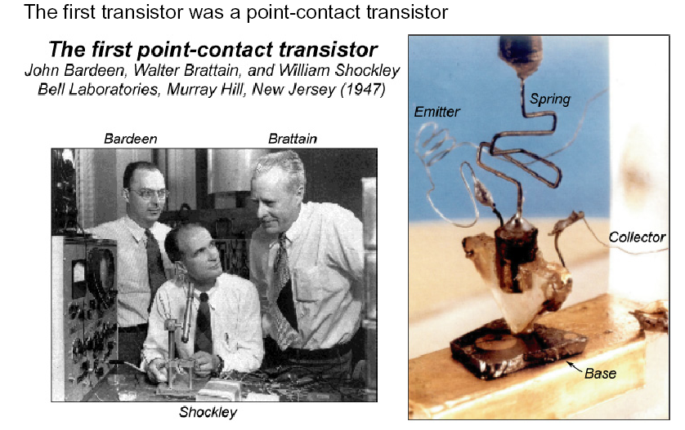
Point-Contact Transistor –
first transistor ever made

Slide 7
Recall p-n junction
P
N
N
P
W
W
+
+
-
-
V_{appl} > 0
V_{appl} < 0
Forward bias, + on P, - on N
(Shrink, V_{bi})
Allow holes to jump over barrier
into N region.
Reverse bias, + on N, - on P
(Expand, V_{bi})
Remove holes and electrons away
from depletion region
I
I
V
V

Slide 8
So if we combine these by fusing their terminals…
P
N
N
P
W
W
+
+
-
-
V_{appl} > 0
V_{appl} < 0
Holes from P region (“Emitter”) of 1st PN junction are
driven by Forward Bias of 1st PN junction into central N region (“Base”)
Driven by Reverse Bias of 2nd PN junction from Base into P region of
2nd junction (“Collector”)

Slide 9
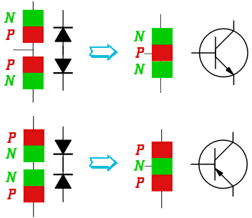
Basic models of BJT
npn transistor
Diode
Diode
pnp transistor
Diode
Diode

Slide 10
Basic models of BJT
Emitter layer is heavily doped

Slide 11
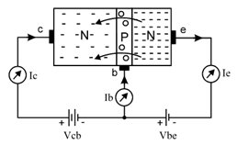
npn BJTs
It contains three semiconductor layers: one p-layer and two n-layers.
The area of collector layer is largest. So it can dissipate heat quickly.
Area of base layer is smallest and it is very thin layer.
Area of emitter layer is medium.
Collector layer is moderately doped. So it has medium number of charges (electrons).
Base layer is lightly doped. So it has a very few number of charges (holes).
Emitter layer is heavily doped. So it has largest number of charges (electrons).
THE P-LAYER IS SANDWICHED BETWEEN TWO N-LAYERS.
The junction between collector layer and base layer is called as collector-base junction or c-b junction.
The junction between base layer and emitter layer is called as base-emitter junction or b-e junction.
The two junctions have almost same potential barrier voltage of 0.6V to 0.7V, just like in a general purpose rectifier diode.

Slide 12
npn BJTs
The collector is connected to high positive voltage with respect to base i.e. Vcb is very high. So c-b junction is reverse biased.
Vbe is low.When we increase Vbe ≥ 0.7V (the value 0.7V is a typical value of potential barrier voltage) the transistor is forward biased.
Now large number of electrons in emitter layer is repelled by negative terminal of Vbe and they flow towards b-e junction.
They cross the junction and enter into small base layer. Here some electrons combine with holes. Also some of them are attracted by positive terminal of Vbe and remaining maximum number of electrons flow into collector layer, crossing the second junction i.e. c-b junction.
The resident electrons of collector are repelled by these (guest) electrons and thus, then all the electrons are present in collector layer are attracted by positive terminal of Vcb. Thus, all these electrons complete their journey back into emitter layer and produce conventional currents in the transistor as shown in the above circuit.

Slide 13
npn BJTs
Now when Vbe is still increased, more electrons are repelled by negative terminal of Vbe. So base-emitter junction is more and more forward biased. Thus the base current (Ib) increases, which in turn increases Ic.
Collector current (Ic) is controled by base current (Ib)
Hence, we can say that collector current (Ic) is the function of base current (Ib).
In all this process, maximum number of electrons from emitter layer flow into collector layer. So collector current is ALMOST EQUAL to emitter current. Hence we say that, collector current is proportional to emitter current.

Slide 14
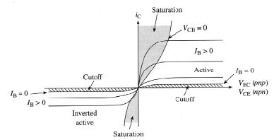
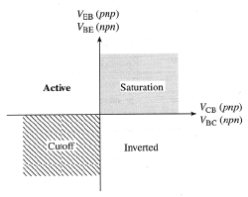
BJTs – Operation Modes
(BJT will operates in one of following three region)
When there is no I_{B} current almost no I_{C} flows
When I_{B} current flows, I_{C} can flow
The device is a current controlled current device
Operational modes
can be defined
based on
V_{BE} and V_{BC}

Slide 15
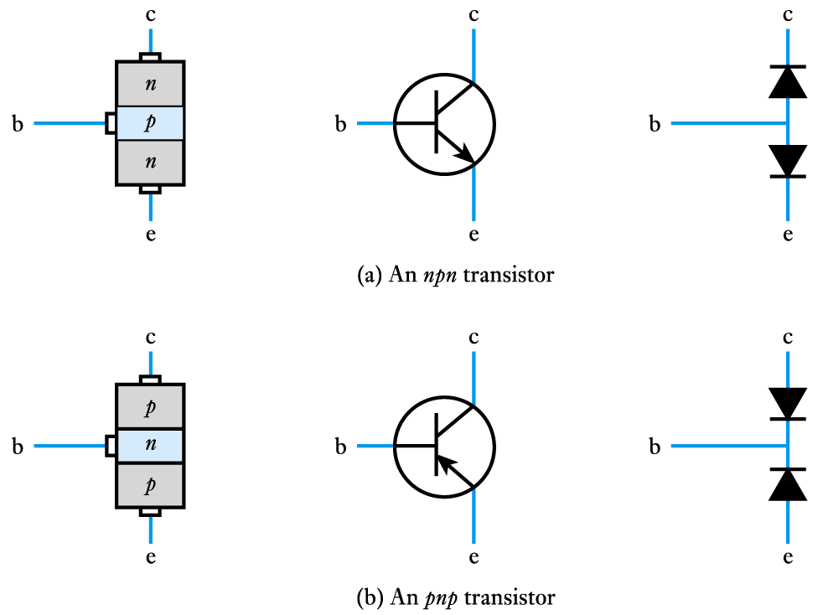
Bipolar Junction Transistors: Operation Modes
Saturation : In this method both the junctions are forward biased. This method is not useful as the transistor is in “saturation” and the current cannot be controlled easily.
Cutoff: In this method both the junctions are reverse biased. This method is also not useful as the transistor is in “cut-off” state since current is zero.
Bias Mode | E-B Junction | C-B Junction
Saturation | Forward | Forward
Active | Forward | Reverse
Cutoff | Reverse | Reverse
Active: This is the most common and popular method used in transistor biasing. In this method, the base-emitter junction is forward biased and collector-base junction is reverse biased. So by adjusting base voltage we can control total current in the transistor easily.

Slide 16
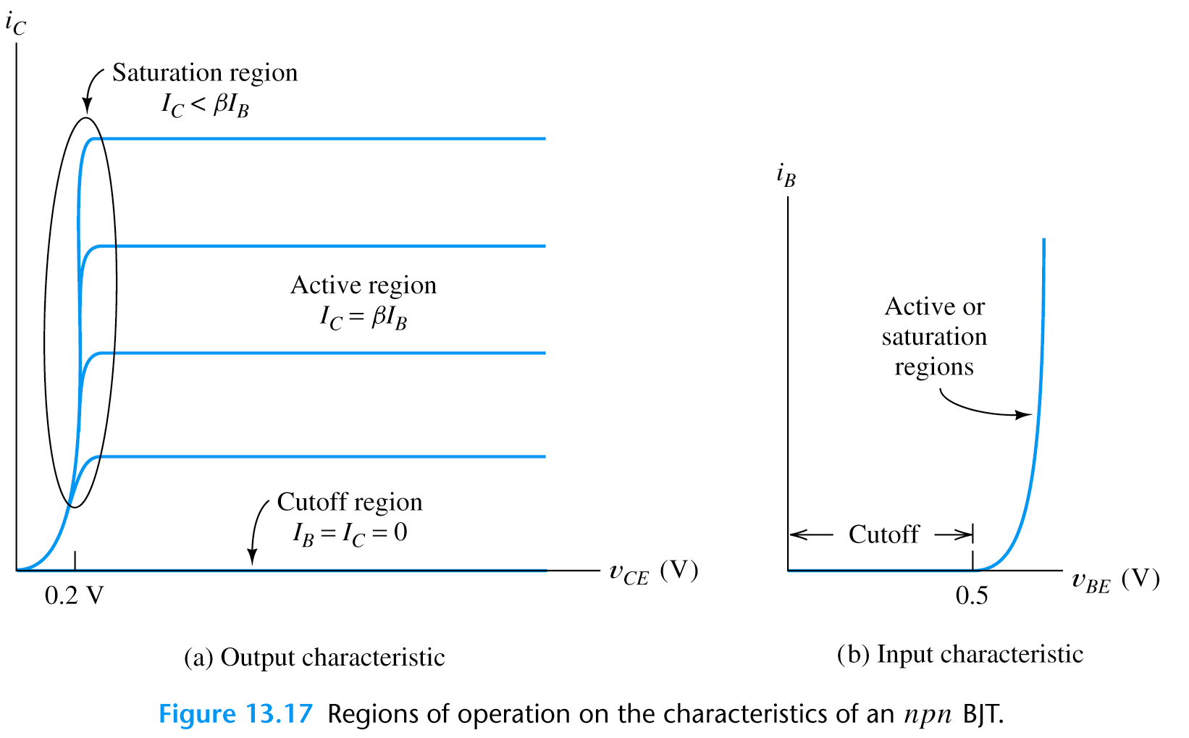
BJT Operating Regions and I V Curves
Output characteristics
region near to the origin is the saturation region
this is normally avoided in linear circuits
Input characteristics
the input takes the form of a forward-biased pn junction
the input characteristics are similar to a semiconductor diode

Slide 17
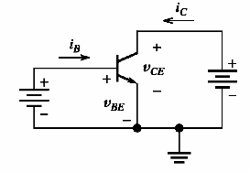
BJTs – Current & Voltage Relationships
Operation mode: v_{BE} is forward & v_{BC} is reverse (Active mode)
The Shockley equation
I_{ES}=saturation current (10⁻¹²-10⁻¹⁶A); V_{T}=kT/q -thermal V (26mV)
The Kirchhoff’s laws
It is true regardless of the bias
conditions of the junction
Useful
parameter

Slide 18
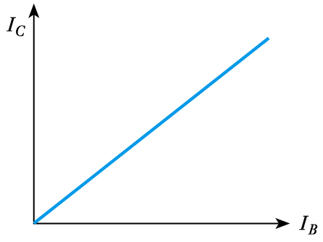
Relationship between the collector current and the base current
characteristic is approximately linear
magnitude of collector current is generally many times that of the base current
the device provides current gain
It is true regardless of the bias
conditions of the junction
Useful
parameter

Slide 19
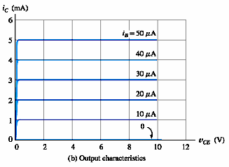
Example:
Please calculate the current gain (β) of this transistor

Slide 20
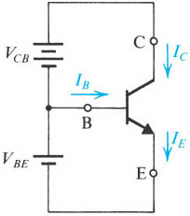
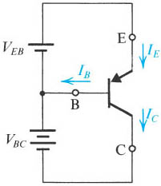
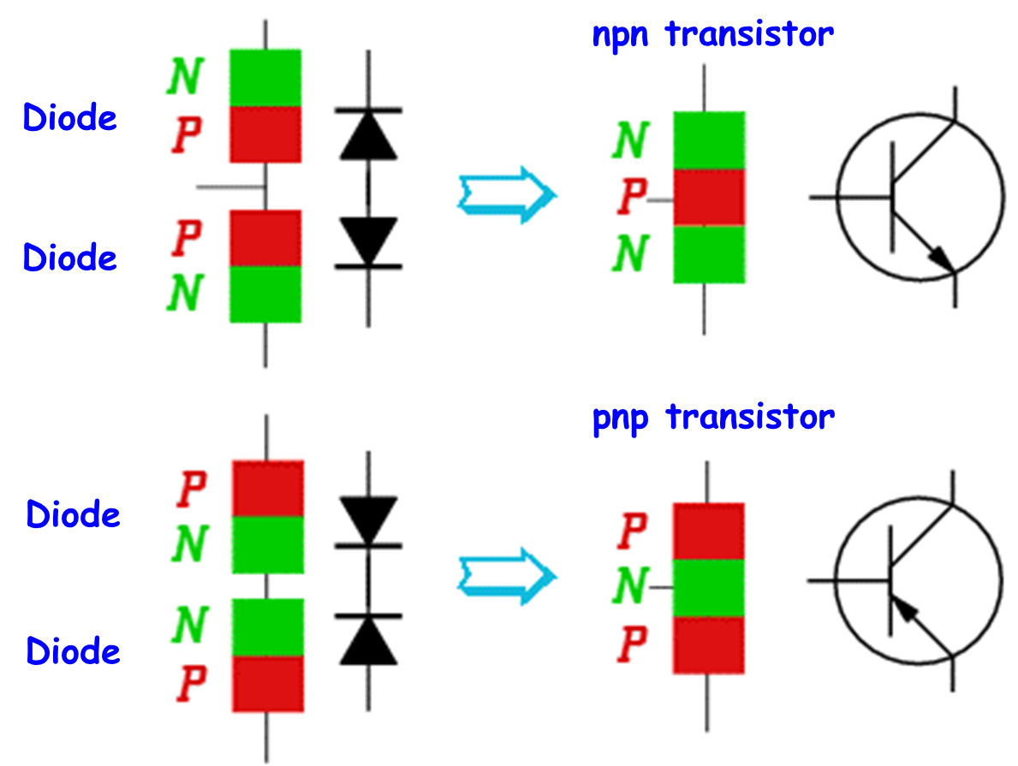
Voltage polarities and current flow in transistors biased in the active mode.
Notes:
sedr42021_0514a.jpg

Slide 21
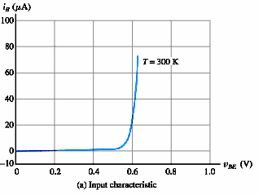
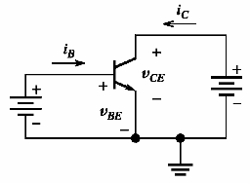
BJTs – Characteristics
Output
Input
V_{BC}<0 or equivalently V_{CE}>V_{BE}
If V_{CE}<V_{BE} the B-C junction is also forward bias and I_{C} decreases (saturation region)
Remember V_{BE} has to be greater
than 0.6-0.7 V

Slide 22
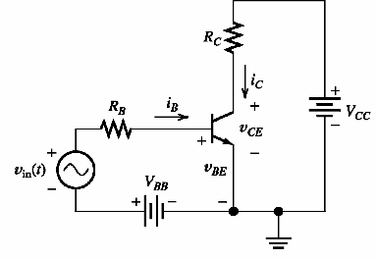
BJTs – Load line analysis
V_{BB}/R_{B}
v_{BB}
Input loop
if i_{B}=0
if v_{BE}=0

Slide 23
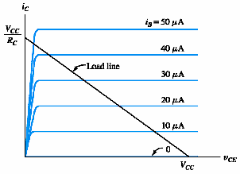
BJTs – Load line analysis
Output loop

Slide 24
Load Line Analysis:
Can be performed in order to determine |V_{BE}| value of transistor in the active and saturation regions.
or
Assumption:
It is assumed that |V_{BE}| = 0.7V in the active and saturation regions.

Slide 25
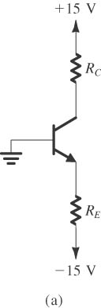
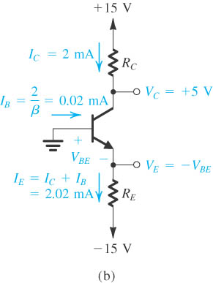
Problem : Analyze the circuits shown in Figure (a) to determine I and V. For all transistors, assume that β = 100 and |V_{BE}| = 0.7V in the active region. (R_{C}=5kΩ, R_{E}=7.07kΩ)
Notes:
sedr42021_0515a.jpg

Slide 26
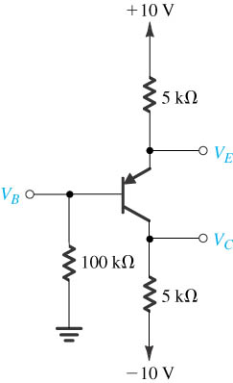
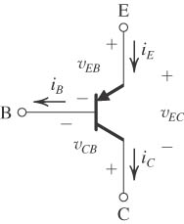
Problem : Analyze the circuits shown in Figure (a) to determine I and V. For all transistors, assume that β = 100 and |V_{BE}| = 0.7V in the active region.
Notes:
sedr42021_0515a.jpg

Slide 27
DC Biasing Circuits of BJTs

Slide 28
Objectives
State the purpose of DC biasing circuits.
Plot the DC load line given the value of V_{CC} and the total collector-emitter circuit resistance.
Describe the Q-point of an amplifier.
Describe and analyze the operations of various bias circuits:
base-bias circuits
voltage-divider bias circuits
emitter-bias circuits
collector-feedback bias circuits
emitter-feedback bias circuits

Slide 29
A generic DC load line.

Slide 30
Example
Plot the DC load line for the circuit shown in Fig.

Slide 31
Example
Plot the DC load line for the circuit shown in Fig. Then, find the values of V_{CE} for I_{C} = 1, 2, 5 mA respectively.
I_{C} (mA) | V_{CE} (V)
1 | 9
2 | 8
5 | 5

Slide 32
Optimum Q-point with amplifier operation.

Slide 33
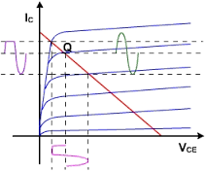
Q-point is not at optimum location
Amplitude of input signal can not be too great
Clipping
Clipping

Slide 34
BIAS CIRCUITS
1. Base bias (fixed bias).
β = DC current gain = h_{FE}

Slide 35
Example
Construct the DC load line for the circuit and plot the Q-point. Determine whether the circuit is midpoint biased.

Slide 36
Example
The circuit is midpoint biased.

Slide 37
(Q-point shift)
The transistor has values of h_{FE} = 100 when T = 25 °C and h_{FE} = 150 when T = 100 °C. Determine the Q-point values of I_{C} and V_{CE} at both of these temperatures. V_{BE}=0.7V
Temp(°C) | I_{B} (μA) | I_{C} (mA) | V_{CE} (V)
25 | 20.28 | 2.028 | 3.94
100 | 20.28 | 3.04 | 1.92
Q(100⁰C)
(25⁰C)

Slide 38
Base bias characteristics.
Circuit recognition: A single resistor (R_{B}) between the base terminal and V_{CC}. No emitter resistor.
Advantage: Circuit simplicity.
Disadvantage: Q-point shift with temp.
Applications: Switching circuits only.

Slide 39
Base bias characteristics.
Load line equations:
Q-point equations:

Slide 40
2. Voltage divider bias.
Assume that I₂ > 10I_{B}.
Assume that I_{CQ} @ I_{E} (or h_{FE} >> 1). Then

Slide 41
Example
Determine the values of I_{CQ} and V_{CEQ} for the circuit shown in Fig.
Because I_{CQ} @ I_{E} (or h_{FE} >> 1),

Slide 42
Example
Verify that I₂ > 10 I_{B}

Slide 43
Which value of h_{FE} do I use?
Transistor specification sheet may list any combination of the following h_{FE} max. h_{FE} min or h_{FE} typ. Use typical value if there is one. Otherwise, use

Slide 44
Example
A voltage-divider bias circuit has the following values:
R₁ = 1.5 kW, R₂ = 680 W, R_{C} = 260 W, R_{E} = 240 W and V_{CC} = 10 V. Assuming the transistor is a 2N3904, determine the value of I_{B} for the circuit.

Slide 45
Stability of Voltage Divider Bias Circuit
The Q-point of voltage divider bias circuit is less dependent on h_{FE} than that of the base bias (fixed bias).
For example, if I_{E} is exactly 10 mA, the range of h_{FE} is 100 to 300. Then
I_{CQ} hardly changes over the entire range of h_{FE}.

Slide 46
Load line for voltage divider bias circuit.
Circuit values are from previous example.

Slide 47
Voltage-divider bias characteristics.
Circuit recognition: The voltage divider in the base circuit.
Advantages: The circuit Q-point values are stable against changes in h_{FE}.
Disadvantages: Requires more components than most other biasing circuits.
Applications: Used primarily to bias linear amplifier.

Slide 48
Voltage-divider bias characteristics.
Load line equations:
Q-point equations (assume that h_{FE}R_{E} > 10R₂):

Slide 49
3. Emitter bias.
Assume that the transistor operation is in active region.
Assume that h_{FE} >> 1.

Slide 50
Example
Determine the values of I_{CQ} and V_{CEQ} for the amplifier shown in Fig.

Slide 51
Load Line for Emitter-Bias Circuit

Slide 52
Emitter-bias characteristics.
Circuit recognition: A split (dual-polairty) power supply and the base resistor is connected to ground.
Advantage: The circuit Q-point values are stable against changes in h_{FE}.
Disadvantage: Requires the use of dual-polarity power supply.
Applications: Used primarily to bias linear amplifiers.

Slide 53
Emitter-bias characteristics.
Load line equations:
Q-point equations:

Slide 54
4. Collector-feedback bias.

Slide 55
Example
Determine the values of I_{CQ} and V_{CEQ} for the amplifier shown in Fig.

Slide 56
Circuit Stability of Collector-Feedback Bias
h_{FE} increases
I_{C} increases (if I_{B} is the same)
V_{CE} decreases
I_{B} decreases
I_{C} does not increase that much.
Good Stability. Less dependent on h_{FE} and temperature.

Slide 57
Collector-Feedback Characteristics
Circuit recognition: The base resistor is connected between the base and the collector terminals of the transistor.
Advantage: A simple circuit with relatively stable Q-point.
Disadvantage: Relatively poor AC characteristics.
Applications: Used primarily to bias linear amplifiers.

Slide 58
Collector-Feedback Characteristics
Q-point relationships:

Slide 59
5. Emitter-feedback bias.

Slide 60
Example

Slide 61
Circuit Stability of Emitter-Feedback Bias
h_{FE} increases
I_{C} increases (if I_{B} is the same)
V_{E} increases
I_{B} decreases
I_{C} does not increase that much.
I_{C} is less dependent on h_{FE} and temperature.

Slide 62
Emitter-Feedback Characteristics
Circuit recognition: Similar to voltage divider bias with R₂ missing (or base bias with R_{E} added).
Advantage: A simple circuit with relatively stable Q-point.
Disadvantage: Requires more components than collector-feedback bias.
Applications: Used primarily to bias linear amplifiers.

Slide 63
Emitter-Feedback Characteristics
Q-point relationships:

Slide 64
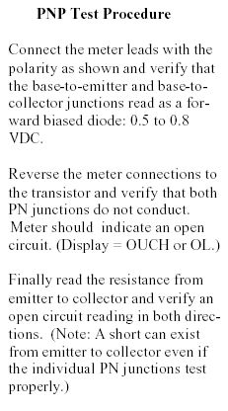
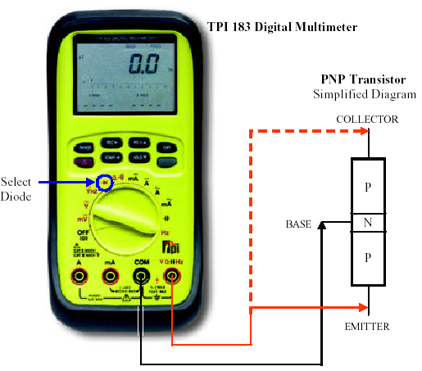
BJTs – Testing

Slide 65
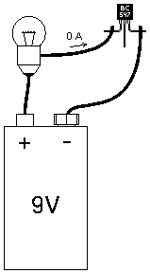
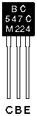
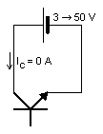
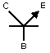
BJTs – Practical Aspects
npn

Slide 66
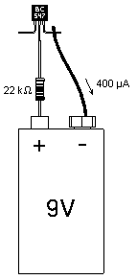
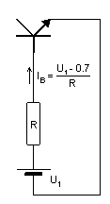

Slide 67
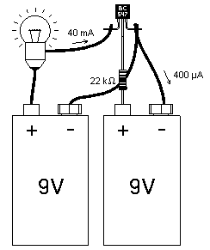
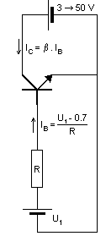
npn

Slide 68
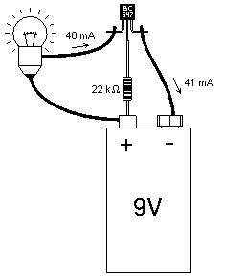
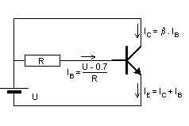
npn

Slide 69
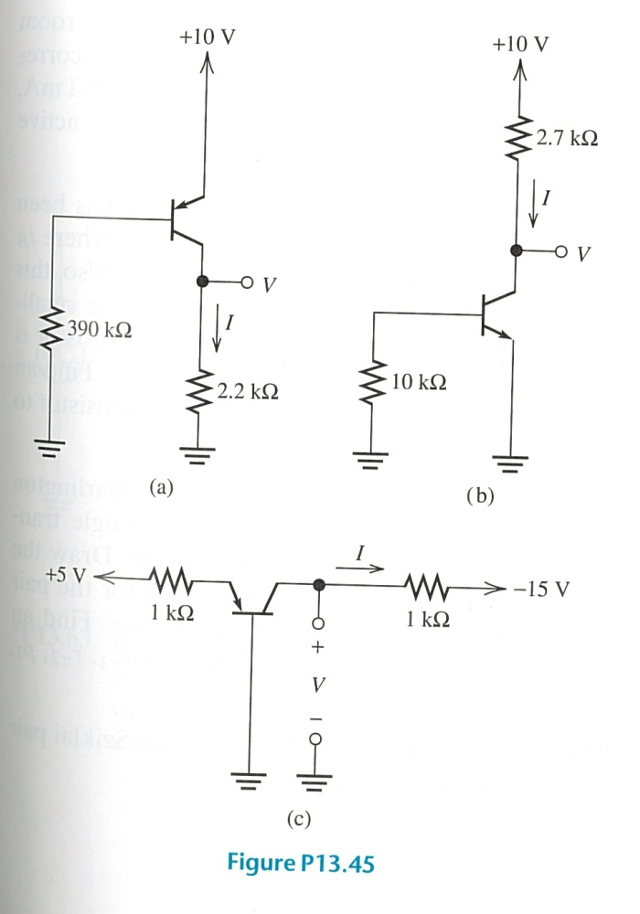
Problem : Analyze the circuits shown in Figure to determine I and V. For all transistors, assume that β = 100 and |V_{BE}| = 0.7V in both the active and saturation regions.

Slide 70
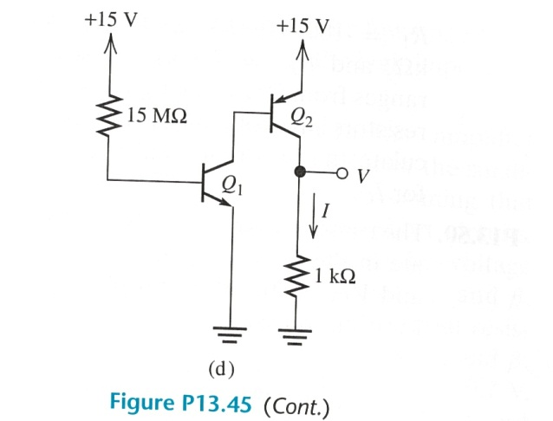
Problem : Analyze the circuits shown in Figure to determine I and V. For all transistors, assume that β = 100 and |V_{BE}| = 0.7V in both the active and saturation regions.

Slide 71
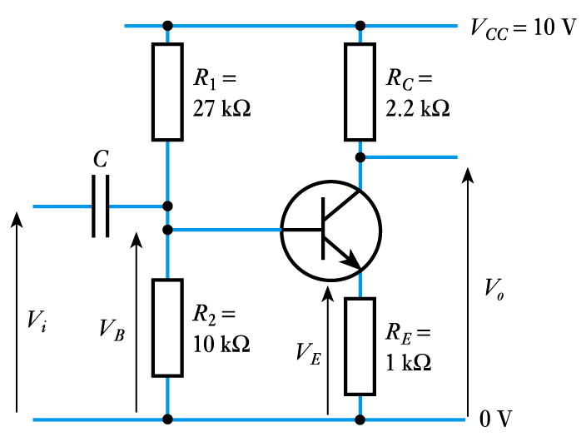
Problem: Suppose that npn transistor has V_{BE} = 0.7V. Determine I_{C} and V_{CE} for transistor and output voltage.
Base current is small, so
Emitter voltage
V_{E} = V_{B} – V_{BE} = 2.7 – 0.7 = 2.0 V
Emitter current
Since I_{B} is small, collector current I_{C} ≈ I_{E} = 2 mA
Output voltage = V_{CC} – I_{C}R_{C} = 10 - 2 mA ×2.2 kΩ = 5.6 V

Slide 72
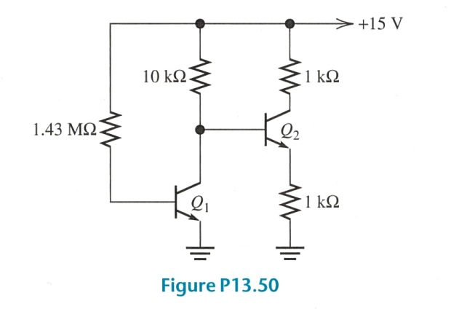
Problem: The transistors shown in figure operate in active region and have β = 100, V_{BE}=0.7V. Determine I_{C} and V_{CE} for each transistor.
I₁
I_{E2}
V_{BE}

Slide 73
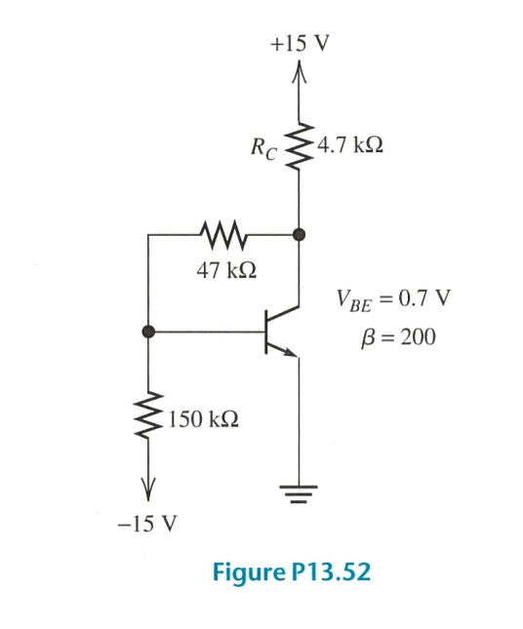
Problem: Analyze the circuit of Figure determine I_{C} and V_{CE}. (β = 100, V_{BE}=0.7V)
I
I_{C}
I₁
I_{B}
I_{E}

Slide 74
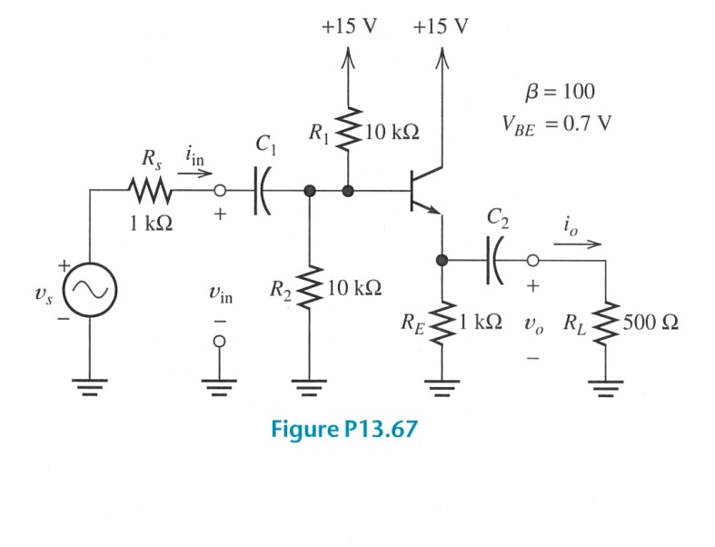
Problem: Consider the emitter-follower amplifier of Figure. Draw the DC circuit and find I_{CQ} (β = 100, V_{BE}=0.7V).
I₁

Slide 75
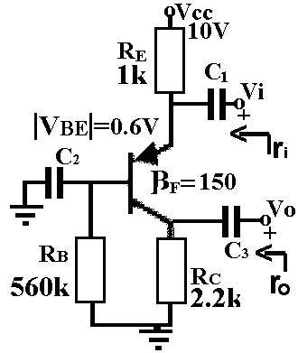
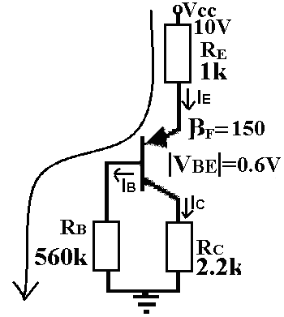
Consider the amplifier shown above. Use the following parameters for your calculations. Transistor parameters : β=150, VBE=0.6V
a. Performing DC analysis and calculate DC operating values of the transistor.

Slide 76
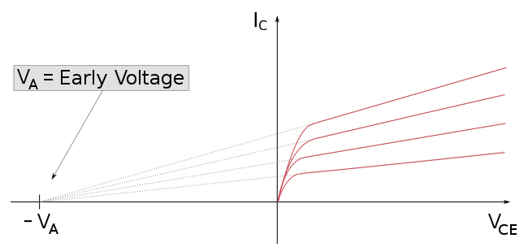
Early Effect
İdeal: Slope is zero
Reallity: Slope is not zero. This nonlinear behaviour is modeled by ‘Early Voltage’ (V_{A}).

Slide 77
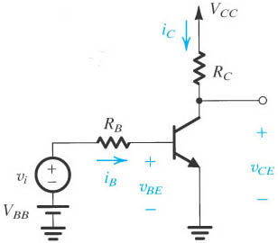
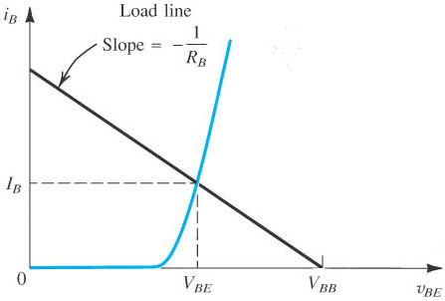
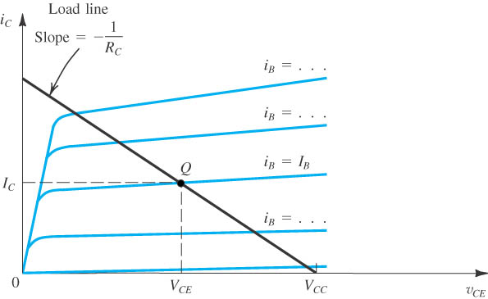
Small-Signal Analysis
A small signal component v_{i} is superimposed on the DC voltage
Circuit whose operation is to be analyzed graphically.
Graphical construction for the determination of the dc base current in the circuit (input)
Graphical construction for the determination of the dc base current in the circuit (output)
Notes:
sedr42021_0527.jpg

Slide 78


Small-Signal Analysis
Graphical determination of the signal components v_{be}, i_{b}, i_{c}, and v_{ce} when a signal component v_{i} is superimposed on the dc voltage V_{BB}
Notes:
sedr42021_0530a.jpg

Slide 79
Small-Signal Equivalent Circuit
Assumption: Early Voltage (V_{A}) is infinite.
Small signal equivalent circuit for BJT:
Transistor is modeled by using input resistance and output current
and

Slide 80
DC ANALYSIS
^{V}CC
R₁
R_{C}
^{C}out
R_{S}
^{C}in
+
v_{s}
-
+
Q₁
+
R_{L} v_{o}
-
^{v}in
R_{E}
R₂
C_{E}
-
Replace all capacitors with OPEN circuits.
Set all AC sources to zero, because they have zero signal component!!!

Slide 81
Constructing the Small-Signal Equivalent Circuit
^{V}CC
R₁
R_{C}
^{C}out
R_{S}
^{C}in
+
v_{s}
-
+
Q₁
+
R_{L} v_{o}
-
^{v}in
R₂
C_{E}
-
To construct small-signal equivalent circuit for entire amplifier, we:
Replace the BJT by its small-signal model.
Replace all capacitors with short circuits.
Set all DC sources to zero, because they have zero signal component!!!
The result is the small-signal equivalent circuit of the amplifier:

Slide 82

Small-Signal Analysis
First perform DC analysis to find small-signal equivalent parameters at the operating point.
Then:
To construct small-signal equivalent circuit for entire amplifier, we:
Replace the BJT by its small-signal model.
Replace all capacitors with short circuits.
Set all DC sources to zero, because they have zero signal component!!!
The result is the small-signal equivalent circuit of the amplifier:

Slide 83


Small-Signal Analysis
A_{voc:} Open circut gain. Gain without ‘Load’
Find voltage gain:
Find input impedance:

Slide 84



Small-Signal Analysis
Find current gain
Find power gain:
Find output impedance:

Slide 85
The parameters of the transistor are β = 100, V_{BE}=0.7V and V_{A} =∞.
(a) Find the dc voltages at the base and emitter terminals.
(b) Find R_{C} such that V_{CEQ} = 3.5 V.
(c) Assuming C_{C} and C_{E} act as short circuits, determine the small-signal voltage gain Av = vo /vs.

Slide 86

Consider the amplifier shown above. Use the following parameters for your calculations. Transistor parameters : β=200, VBE=0.7V, VT=25mV, VA= ∞
a. Find VB and VC of the transistor by performing DC analysis.
b. Find the small signal values of rin, rout, and vout/vin.

Slide 87
Consider an amplifier shown below. Suppose that the value of the coupling capacitors Cc1 and Cc2 are high enough, so they can be considered shorted in small signal analysis. Find the small signal values of rin, rout, and vout/vin.
NPN Transistor Parameters: VBE = 0.7, β = 40, VA = ∞, VT = 25 mV.

Slide 88
For the circuit shown on the left, transistor parameters for identical T₁ and T₂ are V_{A} = ∞, V_{T} = 25 mV, |V_{BE}| = 0,6 V, and h_{fe} = h_{FE} = = β = 100.
a. Determine DC collector currents.
b. Find the small signal voltage gain v_{o}/v_{in}.
c. Determine the input and output resistances.

Slide 89

Transistor as an amplifier:
Transistors are often used as amplifiers to increase input signal in radios, televisions and some other applications .The circuit may be designed to increase the current or voltage level.

Slide 90

Amplifier Classes:
They are defined by the length of their conduction state over some portion of the output waveform.
Class A Amplifiers
Class AB Amplifiers
Class B Amplifiers
Class C Amplifiers

Slide 91

BJT Class A Amplifiers
In a class A amplifier, the transistor conducts for the full cycle of the input signal (360°)
used in low-power applications.
The transistor is operated in the active region, between saturation and cutoff.
saturation is when both junctions are forward biased. the transistor is in cutoff when I_{B} = 0.
The load line is drawn on the collector curves between saturation and cutoff.

Slide 92

BJT Class A Amplifiers

Slide 93

BJT Class B Amplifiers
When an amplifier is biased such that it operates in the linear region for 180° of the input cycle and is in cutoff for 180°, it is a class B amplifier.
Class B amplifier is more efficient than a class A. The transistors in a class B amplifier must be biased above cutoff to eliminate crossover distortion.

Slide 94

The BJT as a Switch
When used as an electronic switch, a transistor normally is operated alternately in cutoff and saturation
A transistor is in cutoff when the base-emitter junction is not forward-biased. V_{CE} is approximately equal to V_{CC}
When the base-emitter junction is forward-biased and there is enough base current to produce a maximum collector current, the transistor is saturated

